Slide 1




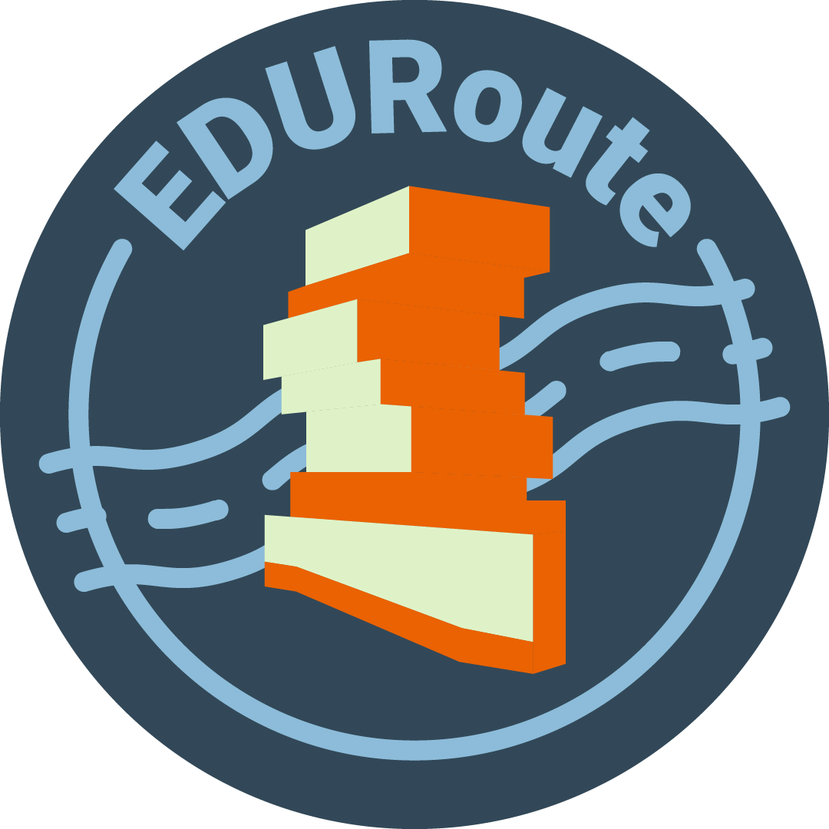








EDURoute An easier way to walk to class
Grace Desrochers, Jason Kwok, Kelvin Lin, Madison Mercado, and Mia Vargas

Slide 2
What is EDUROUTE?
EDURoute is a routing tool designed to facilitate incoming college students’ navigation on campus.
The app uses simplified maps, floor plans, and color-coded guides to make reading directions more accessible.

Slide 3
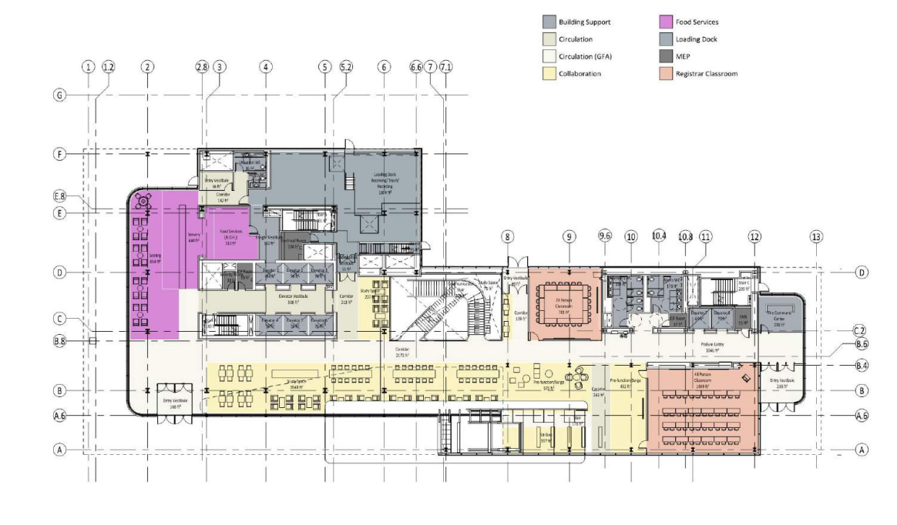
The Issue with navigation
Incoming students often rely on floor plans to see their classrooms, dorms, etc. However, these plans are often designed with lots of detail and may be hard to read for someone navigating college for the first time.

Slide 4
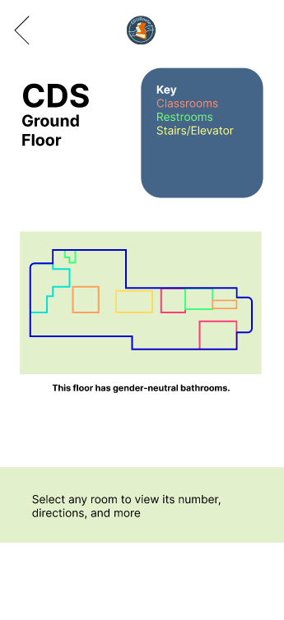
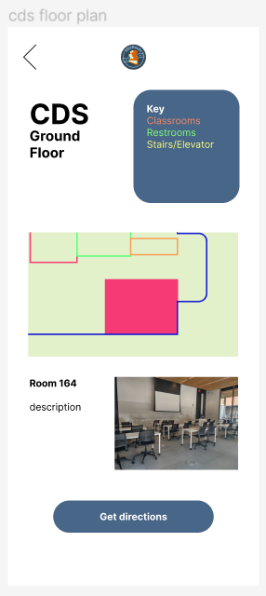
Our solution
By searching for a room number, the app would give directions to and a bird’s-eye view of the desired location. Users also have the option to view simplified versions of maps as well as room descriptions, images, and associated professors.

Slide 5
WHO BENEFITS?
This app would positively contribute to education in a multitude of ways:
Helping people make it to their classes with little stress with clear directions and visual aids.
Teaching people new ways to navigate outside of standard map apps.

Slide 6
WHO BENEFITS?
Incoming students: This app simplifies floor plans to common student spaces and gives detailed descriptions and directions of classrooms.
Visitors: Parents or friends visiting students on campus won’t have to worry about taking faulty directions or getting lost.
Neurodivergent students: The app has a clear interface that makes campus navigation straightforward and prevents overwhelm.
Anyone! : Want to learn about a campus before applying? Want to see how classrooms are designed? Anyone can use the app for any of these reasons!

Slide 7

EDUROUTE ONLINE
To expand the app to other campuses besides BU, future builds and updates could include the inclusion of outsourcing so that students can add their own photos and information about campus buildings to help future students make it to class easier.

Slide 8
Figma FIle
MINI HACK_EDURoute – Figma

Slide 9
Questions?

